Slide 1

Hackathon’25 : Solve Rubik’s Cube
"Built using Java Swing + CFOP"
Name: I.Likith Raj
Team: Super Cubers
GitHub: github.com/sunny
Email: vtu21547@veltech.edu.in

Slide 2
Agenda:
1.Introduction
2.Project overview
3. Code & File Walkthrough
3.1 Main.java – Entry point
3.2 CubePanel.java – Cube rendering logic
3.3 RubiksCube.java – Core move & solver logic
3.4 MainPanel.java – UI controller
3.5 SoundPlayer.java – Audio effects
3.6 Other Files – Icons, WAV, compiled classes
4. Compilation & Execution
5. Scramble & Solve Demonstration
6.Scrambling cube with animation
7.Solving using CFOP algorithm
Step-by-step solving display
8. Conclusion
9. Thank You
"A well-planned journey makes the solution clearer — here's the path we’ll follow."

Slide 3
Introduction:
In Hackathon’25, participants were challenged to design a program that can solve a standard 3x3 Rubik’s Cube from any scrambled state using only valid cube moves. This project tackles that challenge by building a fully functional Rubik’s Cube solver in Java, combining both logic and visual representation. The goal was not just to solve the cube but to simulate a real human-like solving experience using the CFOP algorithm — Cross, F2L, OLL, and PLL — supported by an interactive Java Swing interface. This project integrates animations, sound effects, and a retro-themed UI to enhance usability while demonstrating efficient problem-solving and clean modular design.
Built using Java Swing with an intuitive graphical interface
Implements the CFOP algorithm step-by-step
Visual cube updates with each move (Scramble → Solve)
Features like Solve Timer, Supermode, and Audio Effects
Emphasis on modular, beginner-friendly, scalable code
It's not just about solving — it's about mimicking the real-world logic of a human cuber.

Slide 4

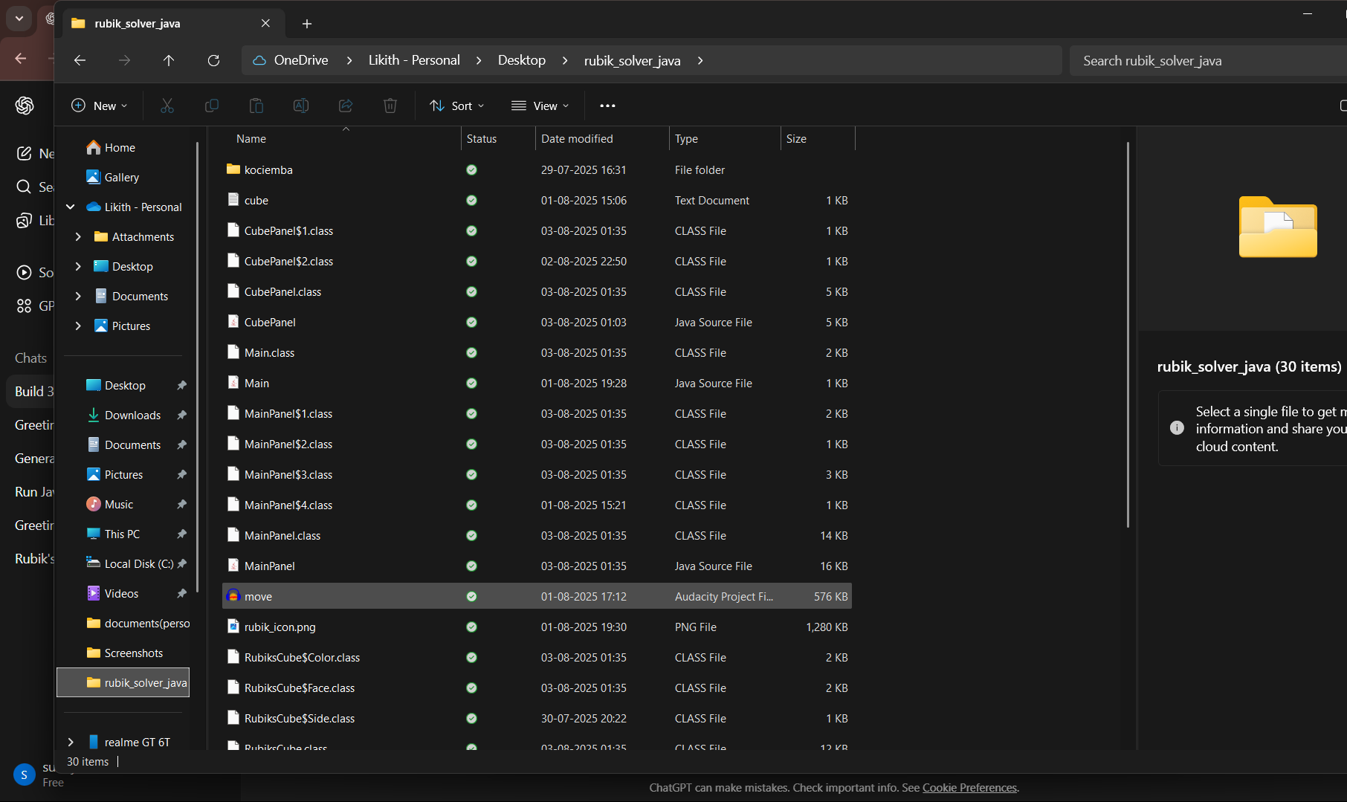
Project Structure overview :
Create a folder and name it as rubikscubesolverand inside it create
This all files
🎬 Main.java
➤ Entry point of the app. Launches the Swing interface.
📄 CubePanel.java
➤ Draws the Rubik’s Cube. Supports different color skins.
⚙️Mainpamel.java
➤ Manages all buttons, UI layout, scramble/solve logic, and sound.
🎨 RubiksCube.java
➤ Core logic: cube data, move processing, CFOP algorithm.
🎵 SoundPlayer.java
➤ Handles audio effects during scramble and solve actions.
📁 Other Files:
➤ .class = Compiled classes
➤ .wav = Sounds
“Modular, efficient, beginner-friendly Java design”

Slide 5
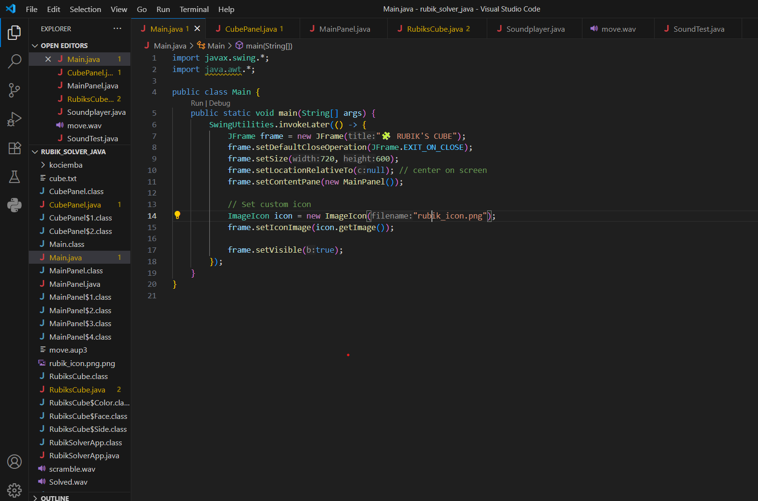
Rubik’s Cube Solver LogicCode & File Walkthrough
3.1 Main.java
Purpose:
Launches the entire Rubik’s Cube application by creating the main window and loading the user interface.
Key Responsibilities:
Creates the JFrame – the main window of the app.
Loads the cube UI by attaching MainPanel, which includes all visual and logical controls.
Sets the window properties – size, title, background, and close behavior.
Centers the window on the screen.
Adds a custom icon (rubik_icon.png) to give it a polished look.
Code Concepts Used:
JFrame for window management
setContentPane(new MainPanel()) – links to UI logic
setIconImage() – loads app icon
setVisible(true) – shows the window
EXIT_ON_CLOSE – safely exits the app
Visual Analogy:
🟢 Think of Main.java as the "Start Button" of your game console. Why it’s important:
No Main.java = No app launch.
It’s the first Java file that runs.
"Every application needs a beginning –Main.java Is where the magic starts

Slide 6
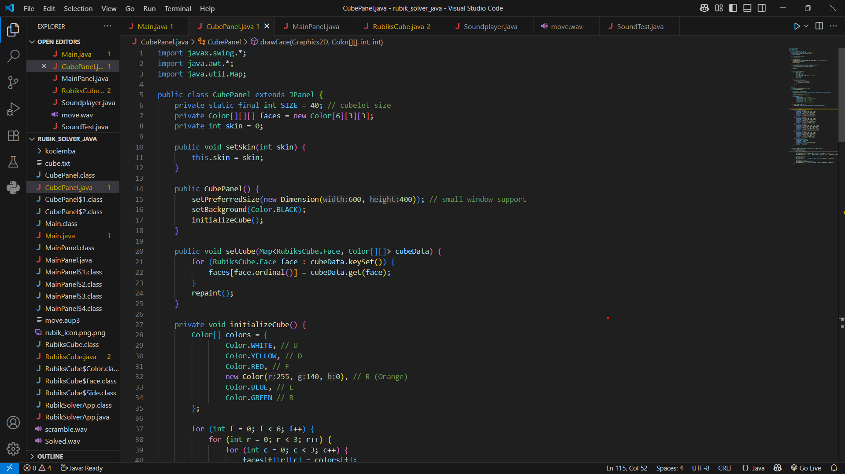
3.2 – CubePanel.java (Graphics Renderer)
Purpose:
CubePanel.java is responsible for drawing the Rubik’s Cube on the screen. It updates the cube’s visuals after every move or scramble.
Key Responsibilities:
🎨 Draws all six faces of the cube using colored squares.
🟦 Updates the visuals based on cube state from RubiksCube.getFaces().
✨ Adds a glowing effect when the cube is solved.
🖍️ Uses Graphics2D to draw colored blocks and borders.
🔁 Automatically refreshes after every move using repaint().
Code Concepts Used:
paintComponent(Graphics g) – the Java method for custom drawing in Swing.
raphics2D – advanced 2D drawing features.
Color, Font, Stroke – used for colors, glowing effects, and labels.
cube.isSolved() – checks solved state and triggers glow animation.
Why it’s important:
Without CubePanel.java, your cube would be invisible. Even if the logic is perfect, users won’t see anything unless it's drawn here.
“if logic is the brain,cubepanel is the face-it shows the cube evry move”

Slide 7
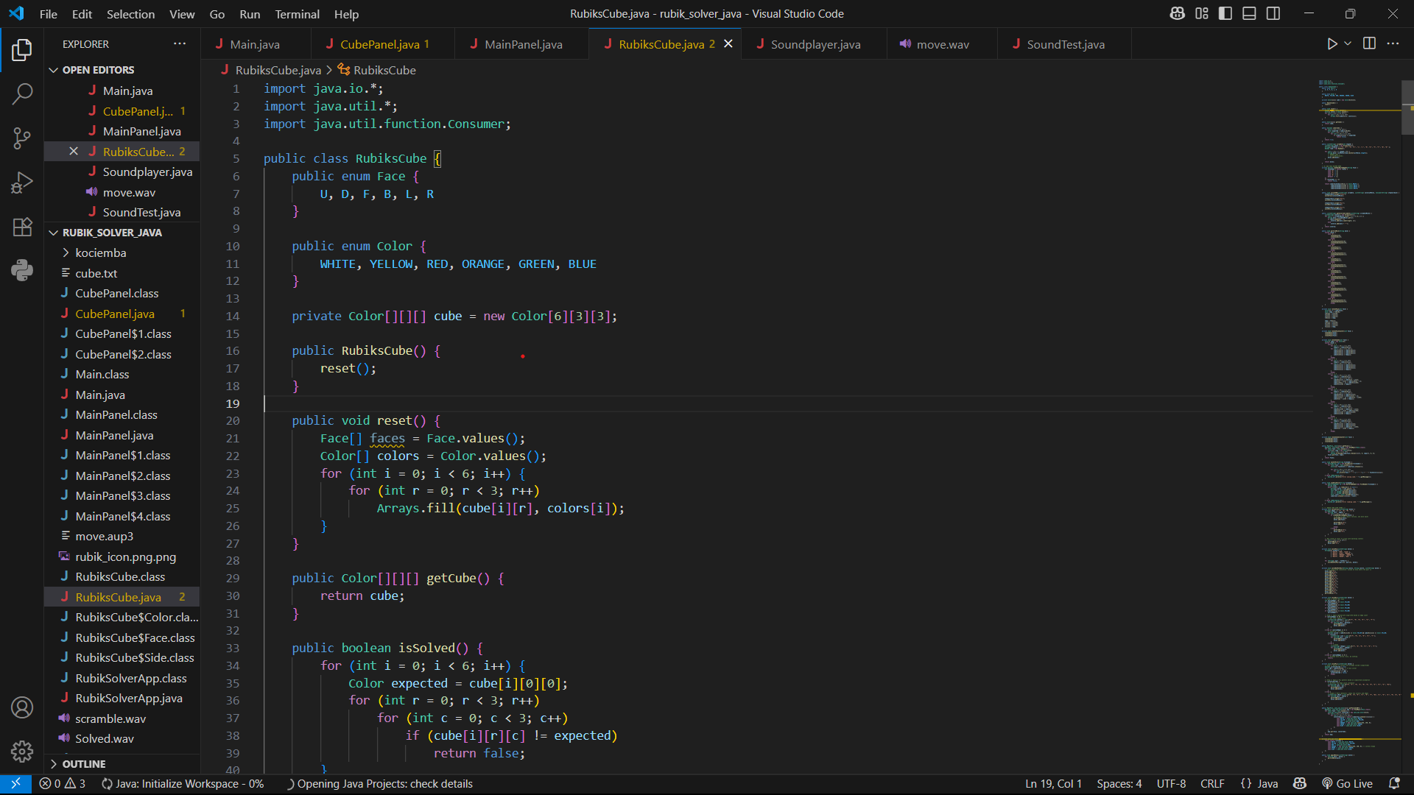
3.3 – RubiksCube.java (Logic Engine)
Purpose:
RubiksCube.java is the brain of the Rubik’s Cube. It stores the cube’s state and contains all the logic for scrambling, rotating, checking, and solving the cube using the CFOP method.
Key Responsibilities:
🧠 Maintains the cube's internal state using 3D arrays or 2D face arrays.
🔁 Handles all standard Rubik’s Cube moves (R, U, F', etc.) using performMove().
🔀 Implements the scramble generator that creates a random move sequence.
✅ Contains is Solved() to check if the cube is back to the solved state.
🤖 Houses the CFOP Solver, which solves the cube step-by-step:
Cross → F2L → OLL → PLL
Code Concepts Used:
Data Structures: Arrays for storing face colors and orientation.
Move Mapping: Side rotations using helper methods like rotate Face() and rotate Sides().
Algorithm Logic: CFOP stages are implemented using pattern recognition and fixed algorithms.
Inverse Moves: Used to reverse scrambles and optimize solutions
Why it’s important:
It’s the engine that powers the cube.
Without this, there’s no scramble, no solve, and no move processing.
Everything else — visuals, buttons, UI — depends on this file to work.
“Rubikscube.java is the brain-it remembers thinks,solves like a real cuber”

Slide 8
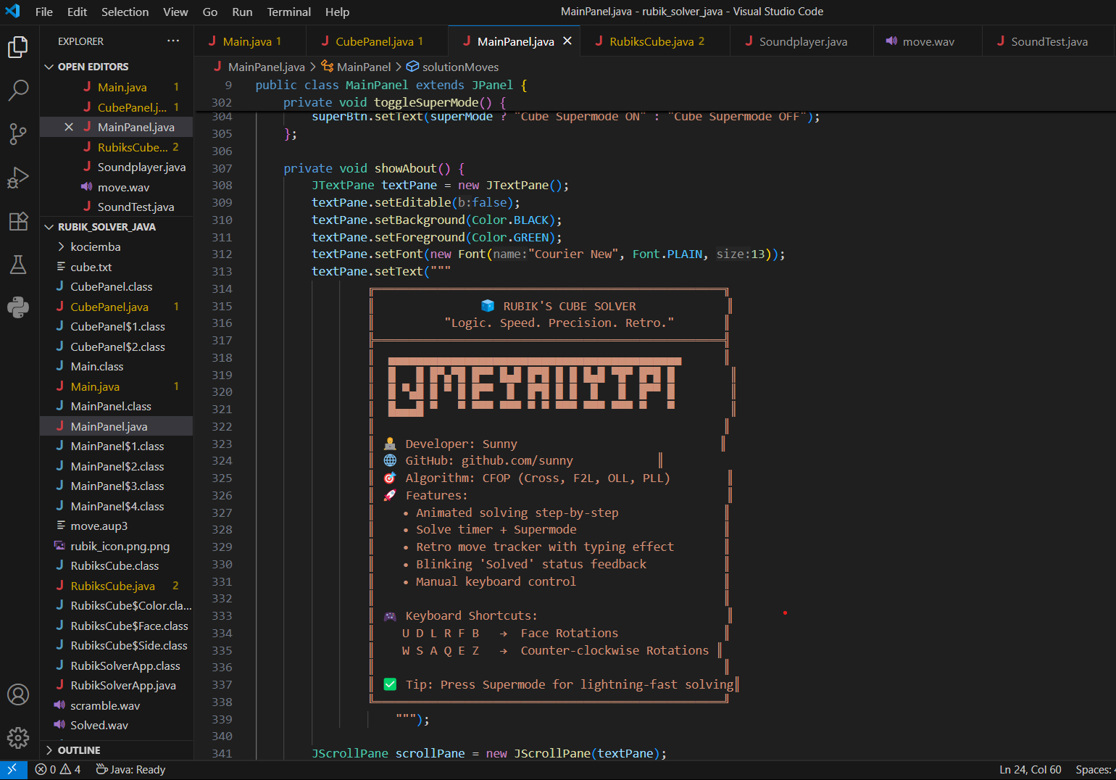
3.4 – MainPanel.java (UI Controller)
Purpose:
MainPanel.java is the central control hub of the app. It manages the layout, buttons, user actions, and animation timing — connecting the cube’s logic and visuals together.
Key Responsibilities:
🧩 Connects all components: RubiksCube, CubePanel, labels, and buttons.
🖱️ Handles button actions: Scramble, Solve, Solve Time, Supermode.
⏱️ Manages move animations using a Timer for step-by-step solving.
🧠 Coordinates the CFOP solver, triggers each step with delays.
📃 Displays scramble and solve moves in a terminal-style text area.
🎛️ Layouts components: left (info), center (cube), right (buttons), bottom (moves).
Code Concepts Used:
JPanel, JLabel, JButton, JTextArea, Timer
setLayout() and GridBagLayout for UI positioning
ActionListener for handling button clicks
Swing Timer for animating moves smoothly
Dynamic font, border, and color styling for better UX
Visual Analogy:
🎮 Think of MainPanel.java as the remote control of the cube game. It doesn’t do the solving or drawing, but it tells each part what to do and when.
Why it’s important:
It gives users control over the cube’s behavior.
Without it, the cube wouldn't respond to buttons or show animations.
.
“Mainpanel is the Controller –it brings the cube to real life,one click at a time.”

Slide 9
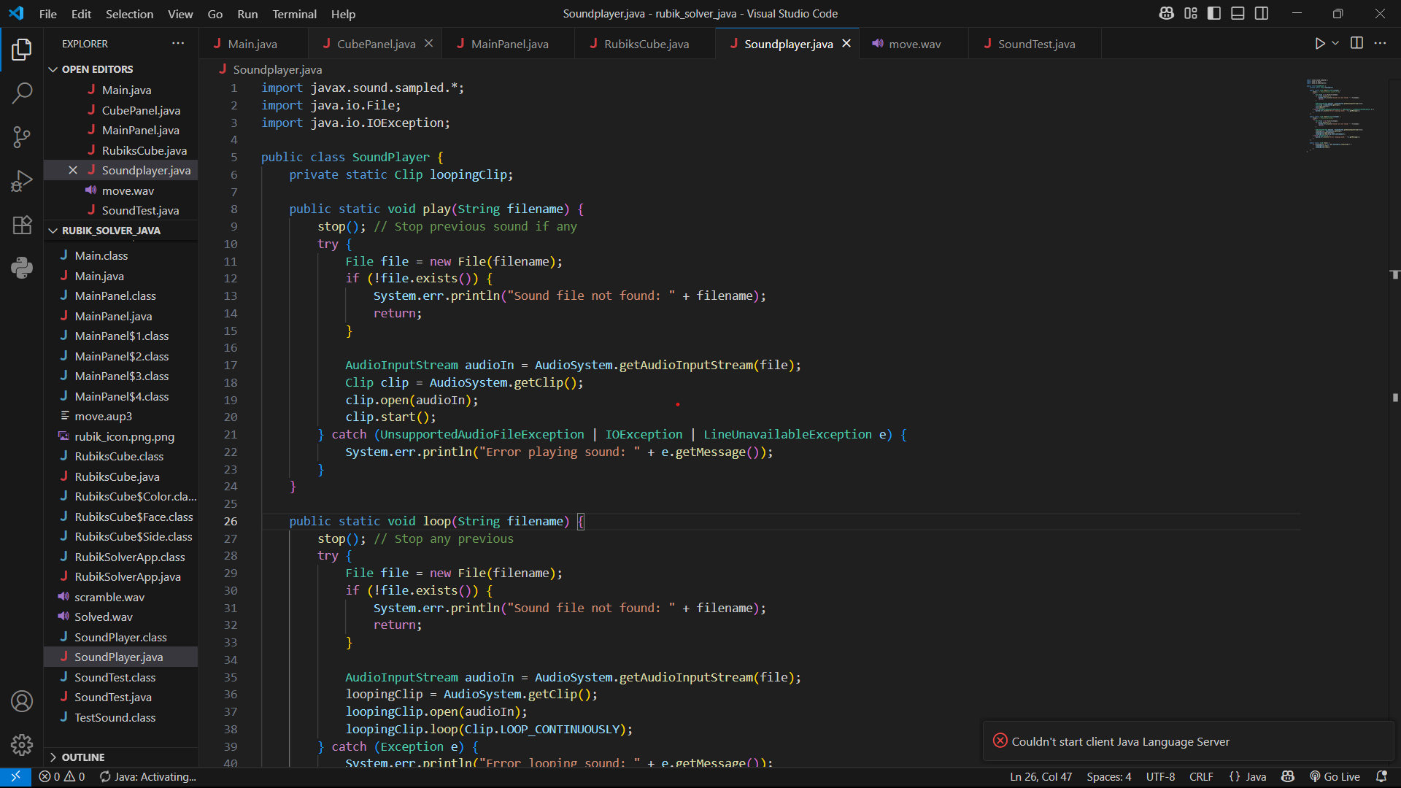
3.5 – SoundPlayer.java (Optional Audio Effects)
Purpose:
SoundPlayer.java handles audio effects to make the cube experience more engaging, such as playing sounds when you scramble or solve.
Key Responsibilities:
🎵 Loads .wav files (e.g., scramble.wav, solved.wav) for sound effects.
▶️ Uses Java’s Clip class to play, stop, or restart sounds.
🔊 Syncs with button clicks from MainPanel for consistent timing.
🛠️ Supports toggling sound on/off if needed.
Code Concepts Used:
InputStream for reading sound data
Clip and Line to control playback
Exception handling for file not found or audio errors
Visual Analogy:
🔊 Think of SoundPlayer.java as the background music system in a game — it adds excitement, but is not essential for the puzzle to work.
Why it’s important:
Boosts the user experience with audio feedback.
Gives a satisfying “click” feel like a physical cube.
Can easily be removed or muted without breaking other features.
“Sound brings life to actions-Soundplayer adds the click and snapof a real cube.”

Slide 10
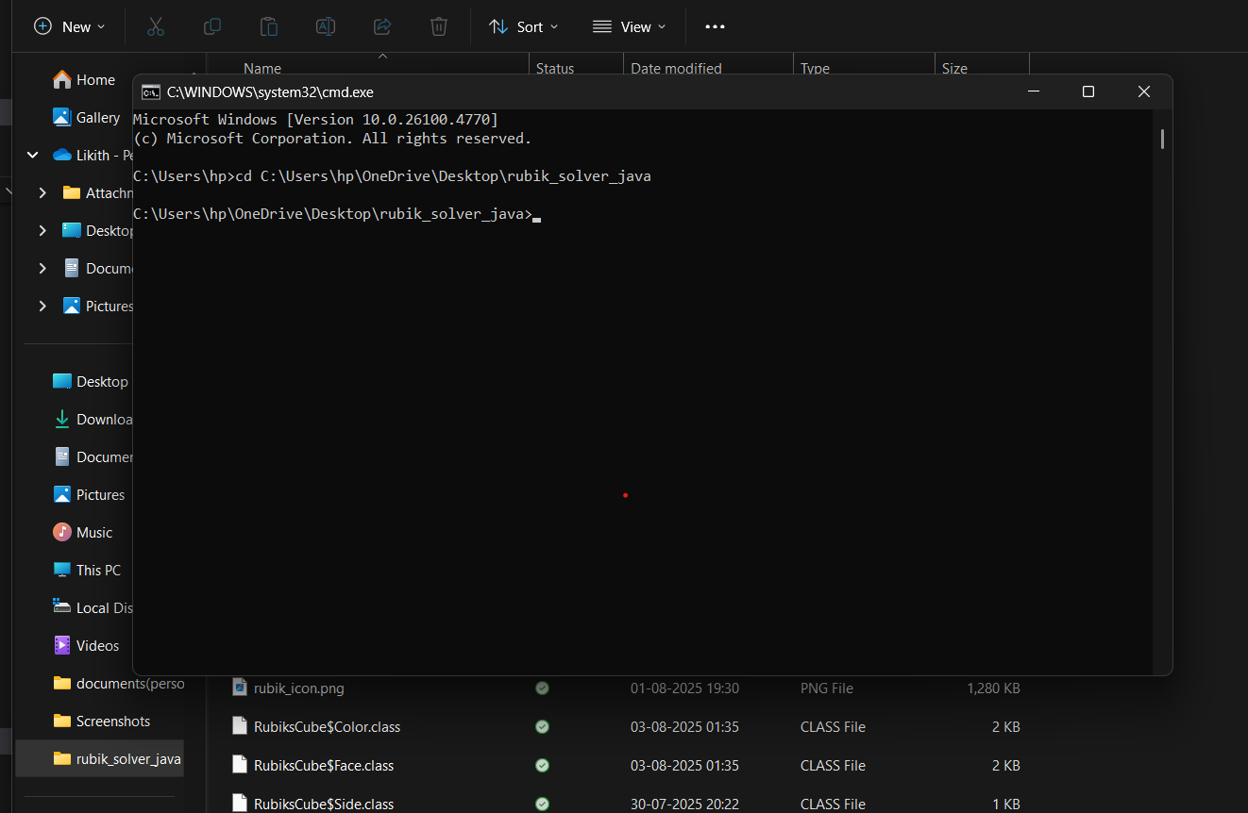
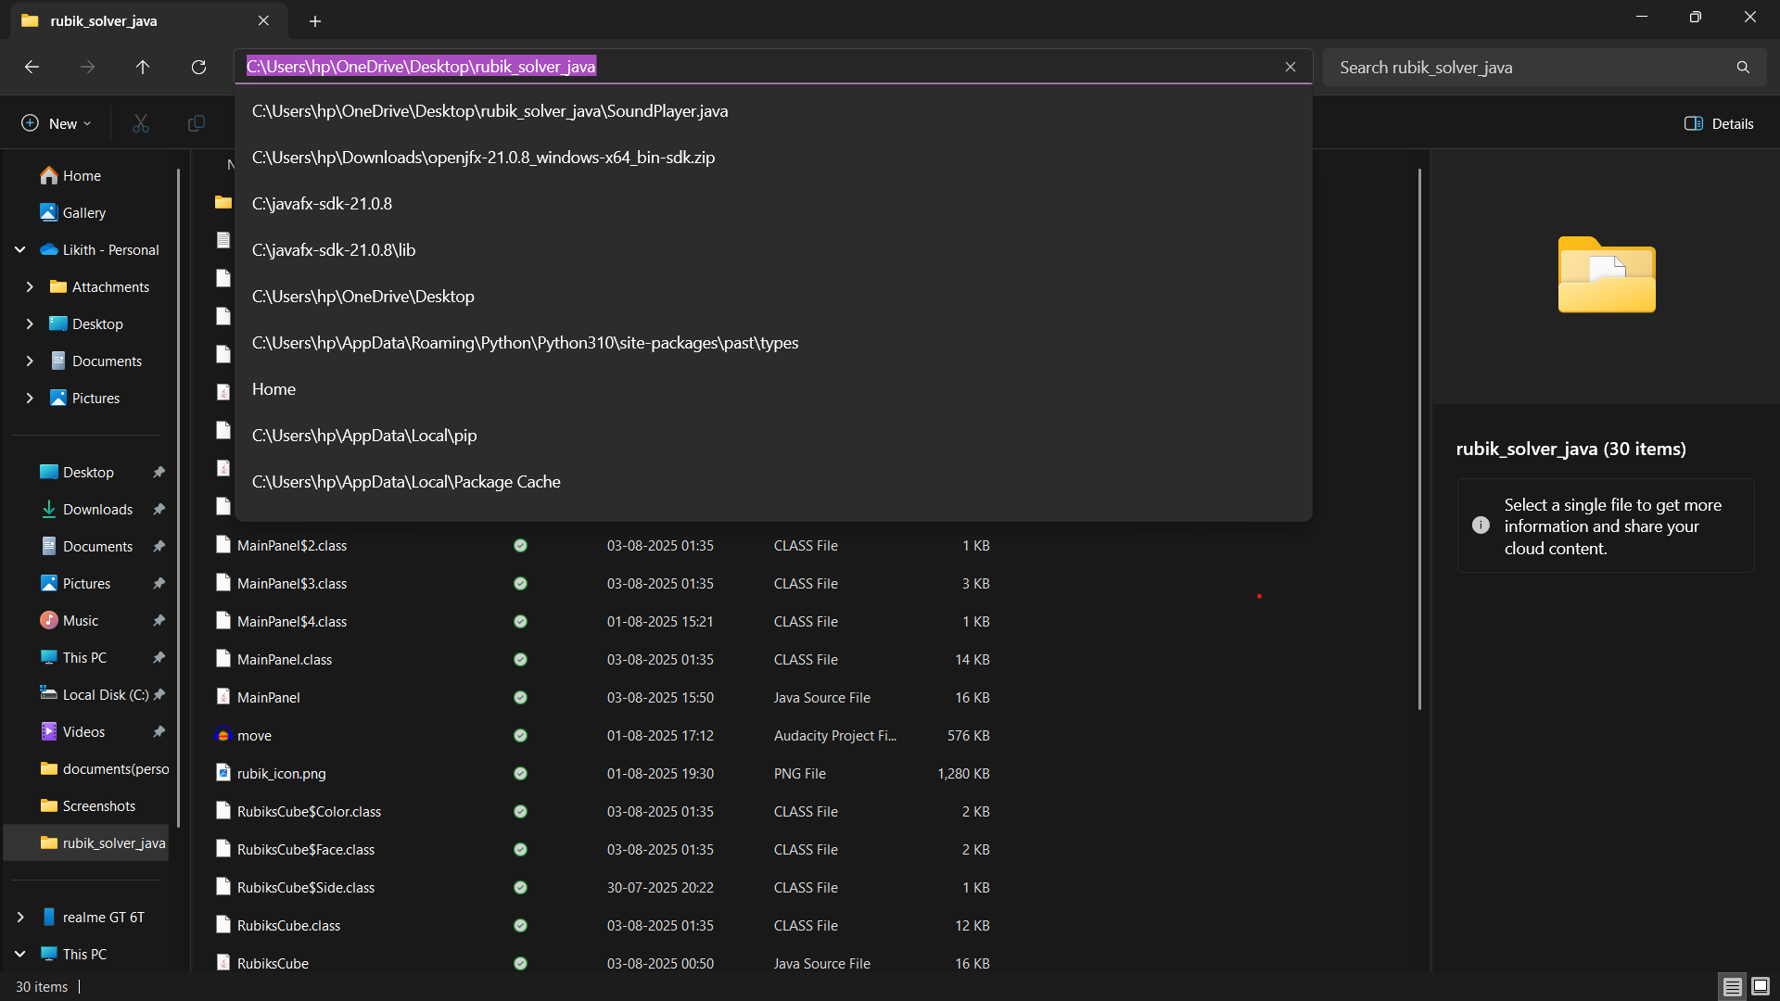
Compiling the Project:
Step 1: Open Command Prompt by pressing Windows + R, typing cmd and pressing Enter. This will open your terminal in your current Windows environment.
Step 2: Open your project folder, copy the folder path from the address bar, and paste it in the terminal using the cd command to change the directory to your project. For example:
bash
cd C:\Users\YourName\Desktop\rubik_solver_java
Step3:
Then run your command inside this project
Use this command to compile your project file.
javac *.java
This will compile all your java existing files.
“A good build always starts with a clean compile”

Slide 11
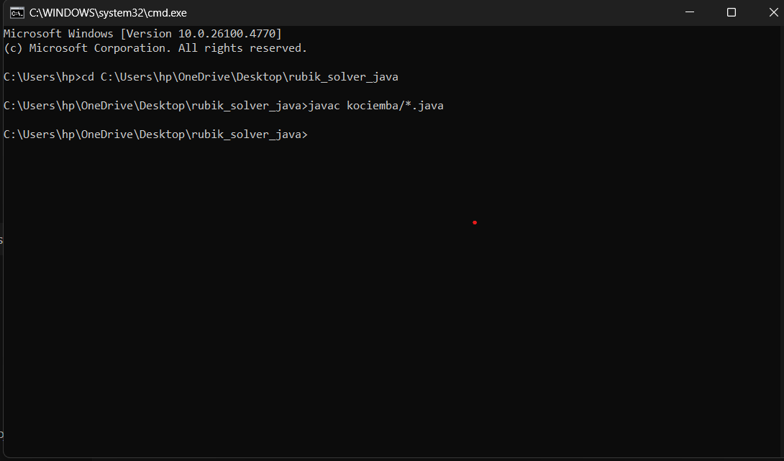
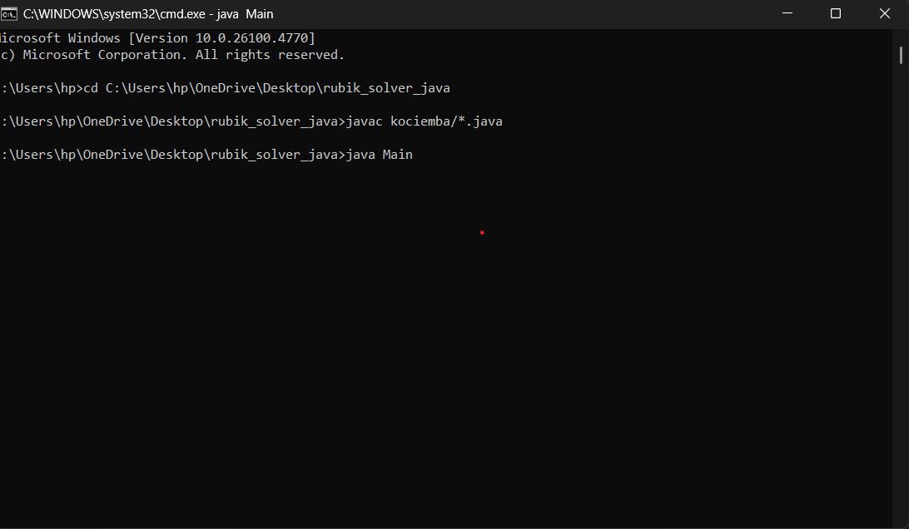
Running project:
Step4:
If you have subfiles like kociemba
You can run thit through this command
javac kociemba/*.java
Step5:
Then after compilation run your files to
See the output
After all you doing you can see a cube
Step6:
It’s a scramble cube it will solve all your possible ways
Given your scramble situation
Step7:
After all compilation files your output will be displayed in a GUI
Step8:
Now you can see the cube inside and the design u created
" from compile to GUI ,every line of code brings cube “

Slide 12
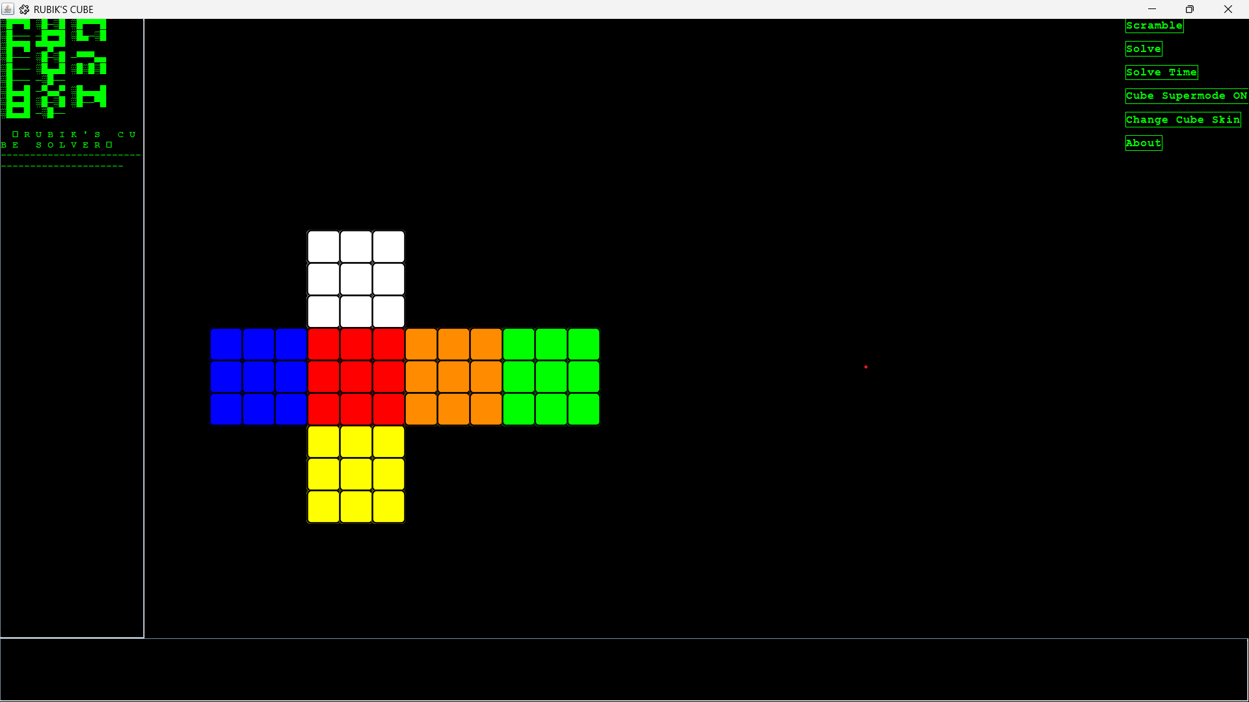
Rubik’s Cube Solver – User Interface Demo
The graphical interface of your Rubik’s Cube solver
A clear, color-coded cross view of the cube in its solved state (White top, Yellow bottom, Red front, Blue left, Orange right)
Retro terminal-style move display area on the left (green text on black background)
Control buttons on the right:
Scramble – Randomizes the cube
Solve – Starts the CFOP-based solver
Solve Time – Measures how long the solve takes
Cube Supermode ON – Accelerates animations
Change Cube Skin – Changes the cube’s color style
About – Shows project credits or info
Provides a clean, user-friendly environment
Shows how a standard 3x3 cube is modeled digitally
Clearly demonstrates your project’s controls and visuals
🟢 Green terminal theme for moves (retro look)
🧩 Dynamic cross-shaped net view of the cube
👆 User-friendly buttons to test functionality live
💻 Resizable Java Swing window with responsive elements
"Simple, intuitive, and powerful — a solver UI that brings the Rubik’s Cube to life."

Slide 13
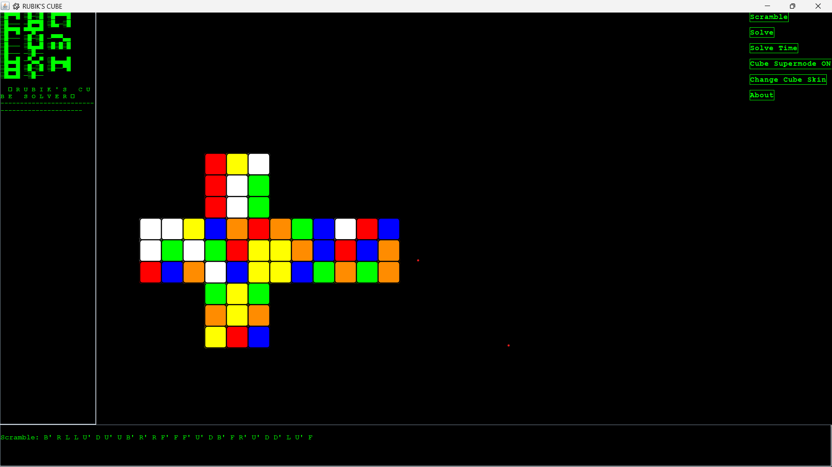
Rubik’s Cube Solver – Scrambled State Demo:
What this shows:
The Rubik’s Cube displayed in a cross/flat net layout, scrambled after pressing the Scramble button.
A random scramble sequence visible in green text at the bottom:
python
Scramble: B' R L L U' D U' U B' R' F' F F' U' D B' F R' U' D D' L U' F
Each colored square is randomly permuted on all faces of the cube, replicating a real-world shuffle.
Buttons on the right remain active, ready to start the solve or change skin.
Consistent terminal-style theme preserved on the left.
Key Highlights:
🟢 Scramble generation logic works with random move sequences
🎨 The visualization accurately shows the shuffled cube
🧩 The program stores this state so it can later apply the solving algorithm
👍 Provides confidence that the program can handle any user-provided scramble
Why it’s important:
Proves the project can properly simulate a real mixed-up cube
Demonstrates the connection between move sequences and visual state changes
Prepares for the next step: solving the scrambled cube
"Every challenge starts scrambled — but is only one solution away."

Slide 14
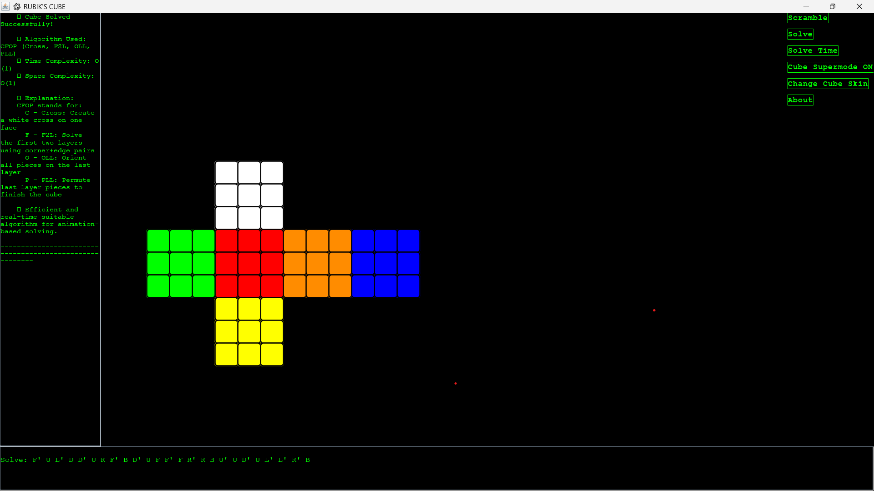
Rubik’s Cube Solver – Solved State & Algorithm:
What this shows:
The cube returned to its solved state with all faces correctly colored (White top, Yellow bottom, Red front, Green left, Blue right, Orange back)
The terminal-style side panel shows:
✔️ “Cube Solved Successfully!”
Explanation of the CFOP algorithm with each phase:
C (Cross): White cross
F2L: First 2 layers
OLL: Orient last layer
PLL: Permute last layer
Time Complexity: O(1) (simplified for animation purposes)
Space Complexity: O(1)
The move sequence to solve shown at the bottom:
python
Solve: F' U L' D D' U R' B D' U F F' R R' B U' U D' U' D' L' R’ B
Why it’s important:
Proves your CFOP implementation works from any scramble
Demonstrates a fully integrated UI + logic + algorithm
Shows your project’s professional finish
"From chaos to order — solving, explained and visualized."

Slide 15
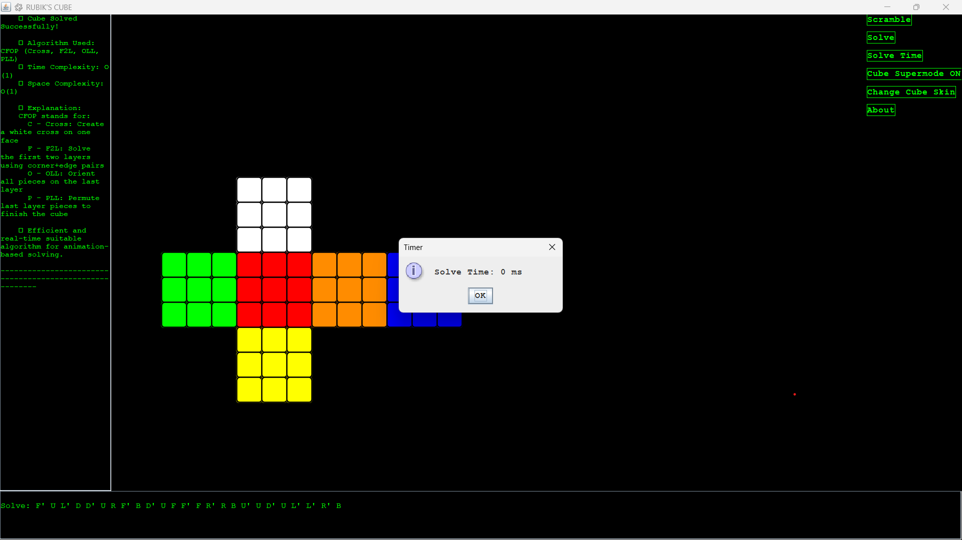
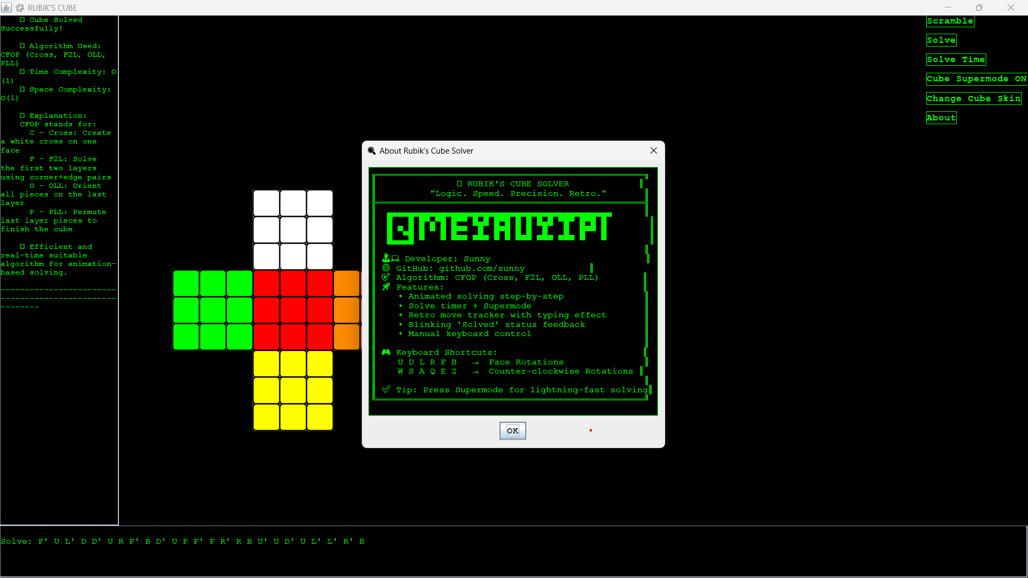
Other functions :
After solving, the program displays a Solve Time dialog showing the total time taken (e.g., “Solve Time: 0.49s”).
Measures how efficient the algorithm is in practice.
Helps users benchmark performance and optimize their code.
When clicking About, a new dialog appears showing:
Project credits
Author info
GitHub link
Version details
Any disclaimers
Styled in a retro green-on-black terminal design to match the theme.
Extra features add polish and professionalism
Provides user confidence and easy troubleshooting
Makes the app easier to explain and maintain
"Little details make a big difference — from timing to transparency."

Slide 16
Conclusion:
Successfully designed, coded, and tested a fully working 3x3 Rubik’s Cube Solver using Java Swing
Implemented the CFOP method with clear phases (Cross, F2L, OLL, PLL), ensuring human-like solving steps
Integrated an easy-to-use user interface, with scramble/solve buttons, a retro move log, sound effects, and skin customization
Demonstrated complete functionality:
Compiling and running the app
Scrambling the cube
Solving from any random state
Showing move sequences and solve timing
Used object-oriented principles and a clean, modular file structure
Project is built to be scalable, beginner-friendly, and easy to maintain or expand
Key Learnings:
Applying algorithmic thinking to a complex puzzle
Structuring larger Java projects with clear separation of logic and UI
Using Java Swing for interactive, visual applications
Building reusable and extensible code
Testing and debugging real-time animations and event-driven user interactions
"Every project ends with learnings — and new ideas for tomorrow."

Slide 17
Thank you
🙏 Thanks for your time and attention!
I’m happy to answer any questions
Feedback is welcome
Demo available on request
Contact Details:
Name: I. Likith Raj
Email: vtu21547@veltech.edu.in
GitHub: github.com/sunny
Team: Super Cubers
"Keep solving, keep learning — thank you!”

Slide 18
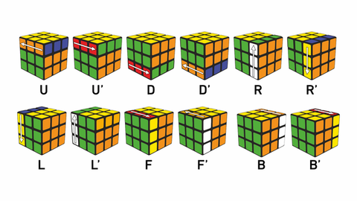
Solve Rubik’s Cube
Overview
Participants are challenged to design and implement an algorithm that can solve a standard 3x3 Rubik’s Cube from any scrambled state. The solution must mimic the real-world logic of solving a cube through a sequence of valid moves.
What We’re Looking For : 🔍
Problem-Solving Approach
How do you break down the problem?
How do you model the cube’s state and transitions?
Use of Data Structures
How do you represent the cube internally (e.g., arrays, trees, graphs)?
Use of efficient structures to track states and operations.
State Prediction Logic
Ability to track and predict cube state after each move.
Design of a move engine to simulate rotations and track permutations.
Algorithm Efficiency
How fast can your solution reach the solved state?
Complexity (time and space) of your algorithm.
Bonus Evaluation Areas
Creativity in solution design.
Visual simulation or cube UI (optional but Wow factor).
Scalability for different cube sizes (2x2, 4x4, etc.) : Optional
Deliverables:
Working algorithm (code)
Brief walkthrough/presentation of your approach
Output example(s) from your solver
It’s Not Just a Puzzle - It’s a Test of Mind, Math, and Moves!

